Slide 1

MULTITHREADING

Slide 2
MULTITASKING
Multitasking is a process of executing multiple tasks simultaneously. We use multitasking to utilize the CPU. Multitasking can be achieved in two ways:
Process-based Multitasking (Multiprocessing)
Thread-based Multitasking (Multithreading)

Slide 3
PROCESS BASED MULTITASKING
Each process has an address in memory. In other words, each process allocates a separate memory area.
A process is heavyweight.
Cost of communication between the process is high.
Switching from one process to another requires some time for saving and loading registers, memory maps, updating lists, etc.

Slide 4
THREAD BASED MULTITASKING
Threads share the same address space.
A thread is lightweight.
Cost of communication between the thread is low.

Slide 5
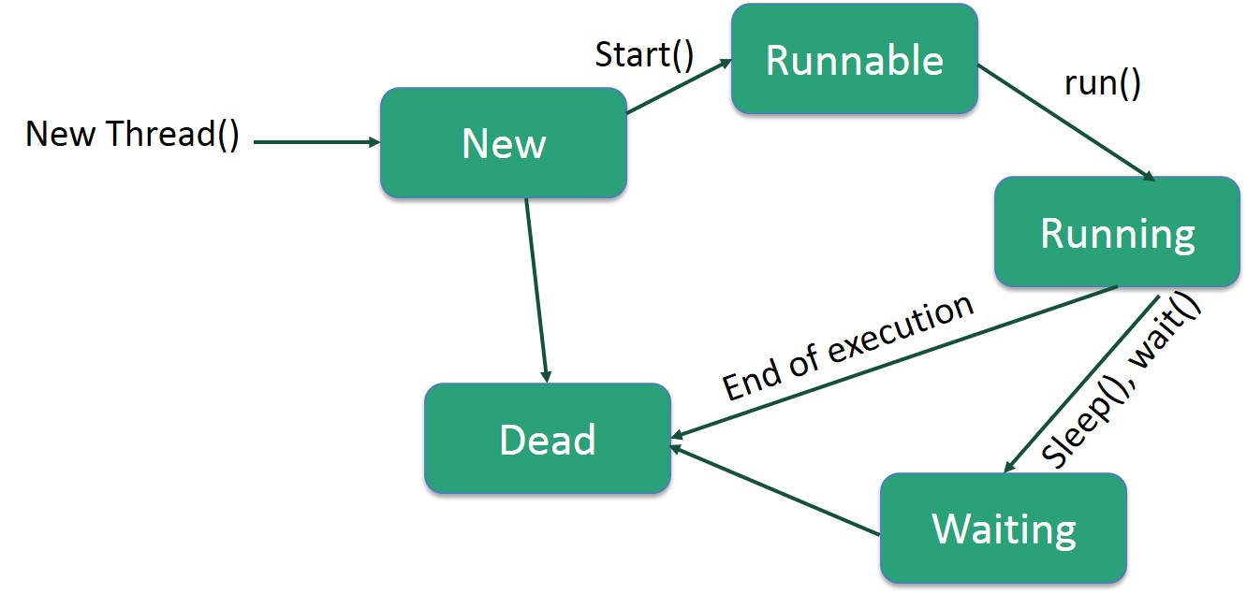

LIFE CYCLE OF A THREAD

Slide 6
JAVA THREAD POOL
Java Thread pool represents a group of worker threads that are waiting for the job and reuse many times.
In case of thread pool, a group of fixed size threads are created. A thread from the thread pool is pulled out and assigned a job by the service provider. After completion of the job, thread is contained in the thread pool again.
Advantage of Java Thread Pool
Better performance It saves time because there is no need to create new thread.

Slide 7
THREAD GROUP
Java provides a convenient way to group multiple threads in a single object. In such way, we can suspend, resume or interrupt group of threads by a single method call.
A ThreadGroup represents a set of threads. A thread group can also include the other thread group. The thread group creates a tree in which every thread group except the initial thread group has a parent.

Slide 8
DAEMON THREAD
It provides services to user threads for background supporting tasks. It has no role in life than to serve user threads.
Its life depends on user threads.
It is a low priority thread.

Slide 9
THREAD PRIORITY
public static int MIN_PRIORITY
public static int NORM_PRIORITY
public static int MAX_PRIORITY
Default priority of a thread is 5 (NORM_PRIORITY).
The value of MIN_PRIORITY is 1 and
the value of MAX_PRIORITY is 10.

